Slide 1
Lecture 36
Dec. 11th , 2019
Exam 4 next Friday—Dec. 13th. I have decided to incorporate exam 4 material into the final exam. ~30% new material/~70% cumulative
Final exam Thursday, Dec. 19th, 8-10 am. No non-emergency rearrangements please.
Lab tomorrow---Review and prepare.

Slide 2
Where were we?
Analysis of cancer cells sometimes shows that they have abnormally active telomerase.
Explain why this might not be surprising.

Slide 3
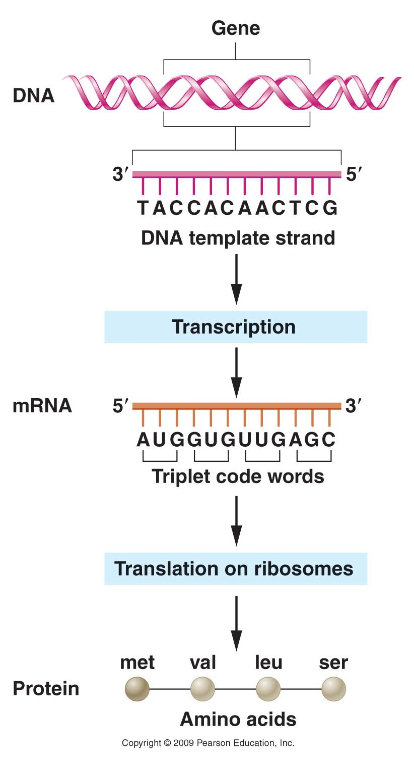
Chapter 13…
We will still focus on the “original” central dogma of genetics.
  -The classical view
  of the flow of genetic
  information from DNA
  to protein.

Slide 4
Gene expression begins with transcription of DNA into RNA.
Mechanism has many similarities to replication.
  A polymerase enzyme copies a DNA template (single strand)
  New strand of RNA is complementary to the DNA sequence.

Slide 5
DNA (portion of a gene)
3’----G-C-A-A-T-C-T-A----5’…
5’----C-G-T-T-A-G-A-T---3’…

Slide 6
coding strand
DNA
3’----G-C-A-A-T-C-T-A----5’…
5’----C-G-T-T-A-G-A-T---3’…

Slide 7
coding strand
Non-coding strand
DNA
3’----G-C-A-A-T-C-T-A----5’…
5’----C-G-U-U-A-G-A-U---3’…
(complementary RNA)
5’----C-G-T-T-A-G-A-T---3’…

Slide 8
Several key differences
Only specific regions of the DNA are transcribed into RNA (Genes)
  --90+% of bacteria genome is genes
  --<2% of human genome is genes (as traditionally defined)
  2. Within genes only one of the 2 strands is transcribed (coding strand)

Slide 9
Newly made RNA dissociates from the DNA template. (not like semi-conservative replication)
Enzyme is RNA polymerase.

Slide 10
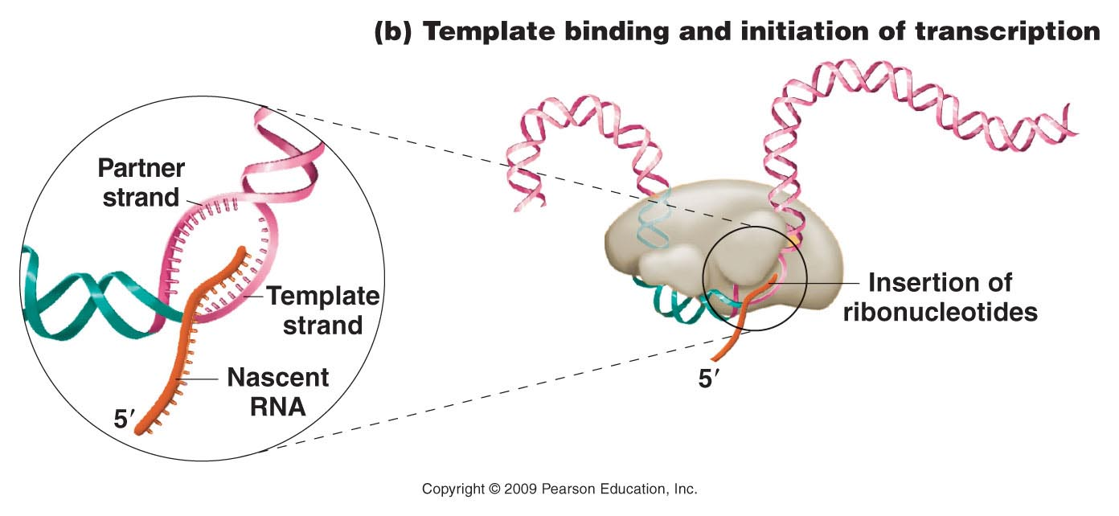
RNA polymerase

Slide 11
Transcription varies greatly among different cells.
  Different cell types express unique subsets of genes
  Changes in environment of cells (stressors, changes in nutrients etc.), trigger changes in expression programs. A different subset of genes may be transcribed in the same cell.
  Different stages in development call for different subsets of genes to be transcribed.

Slide 12
General structure of a gene.
Regulatory sequences—eg. the PROMOTER
Protein-coding sequences
Transcription actually starts here
Usually “upstream” from the start site for transcription

Slide 13
Regulatory sequences bind to key proteins involved in transcription.
The promoter binds RNA polymerase itself.

Slide 14
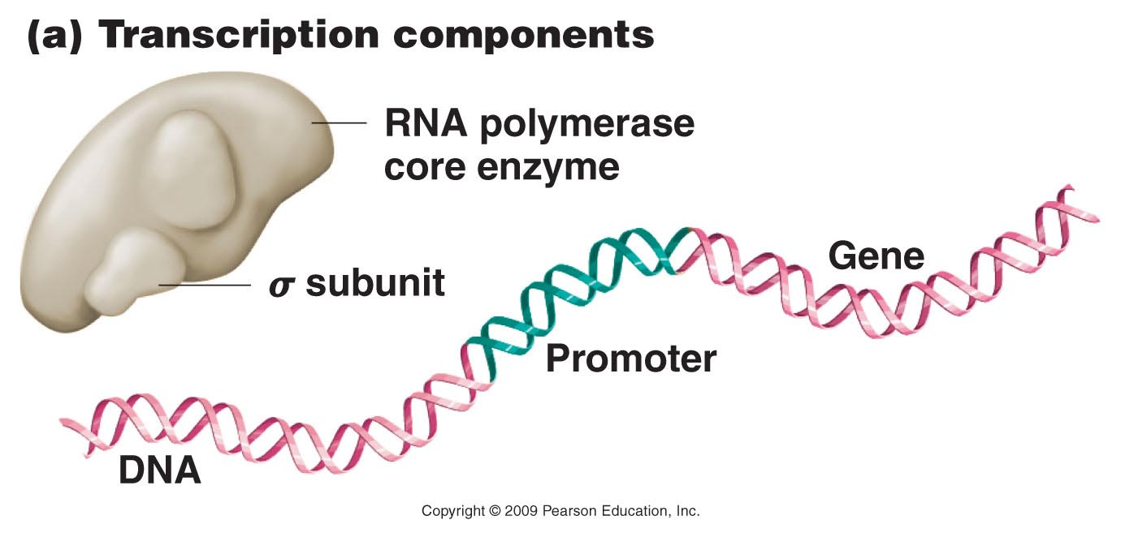
(E. coli)
Important for binding the promoter---initiation of transcription
Figure 14.9a
Notes:
Figure 14-9a The early stages of transcription in prokaryotes, showing (a) the components of the process; (b) template binding at the –10 site involving the sigma subunit of RNA polymerase and subsequent initiation of RNA synthesis; and (c) chain elongation, after the sigma subunit has dissociated from the transcription complex and the enzyme moves along the DNA template.

Slide 15
Figure 14.9b
Notes:
15
Figure 14-9b The early stages of transcription in prokaryotes, showing (a) the components of the process; (b) template binding at the –10 site involving the sigma subunit of RNA polymerase and subsequent initiation of RNA synthesis; and (c) chain elongation, after the sigma subunit has dissociated from the transcription complex and the enzyme moves along the DNA template.

Slide 16
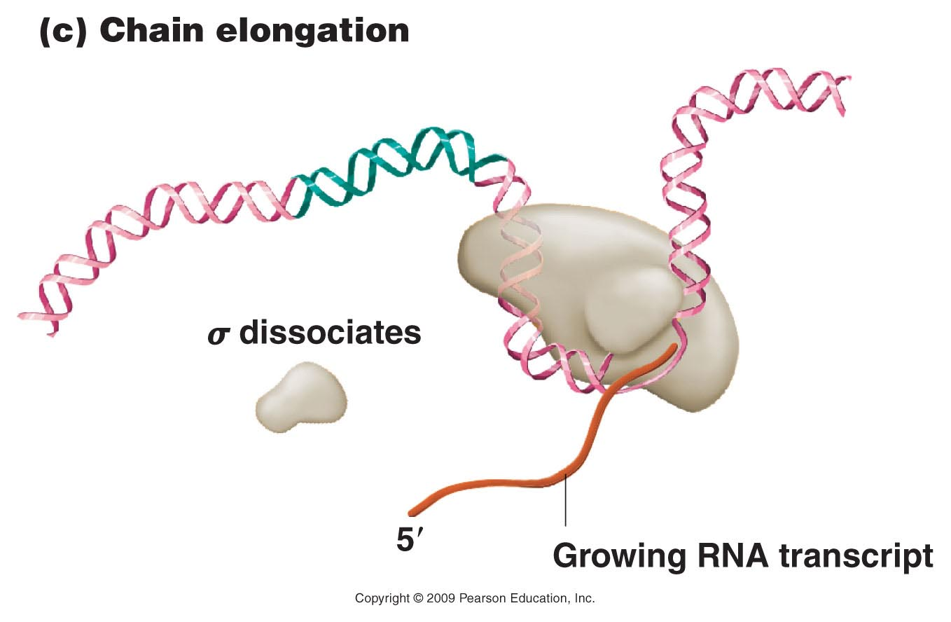
Not needed once transcription is initiated
Figure 14.9c
Notes:
16
Figure 14-9c The early stages of transcription in prokaryotes, showing (a) the components of the process; (b) template binding at the –10 site involving the sigma subunit of RNA polymerase and subsequent initiation of RNA synthesis; and (c) chain elongation, after the sigma subunit has dissociated from the transcription complex and the enzyme moves along the DNA template.

Slide 17
Product is mRNA
  In prokaryotes, few if any modifications are made to the mRNA.
  In fact, translation begins before transcription is complete

Slide 18
Eukaryotes…
Eukaryotic mRNA
  Undergoes many modifications prior to translation
    Modifications at both 5’ and 3’ end
    Removal of non-coding sequences (introns) that interrupt the coding sequence (exons)

Slide 19
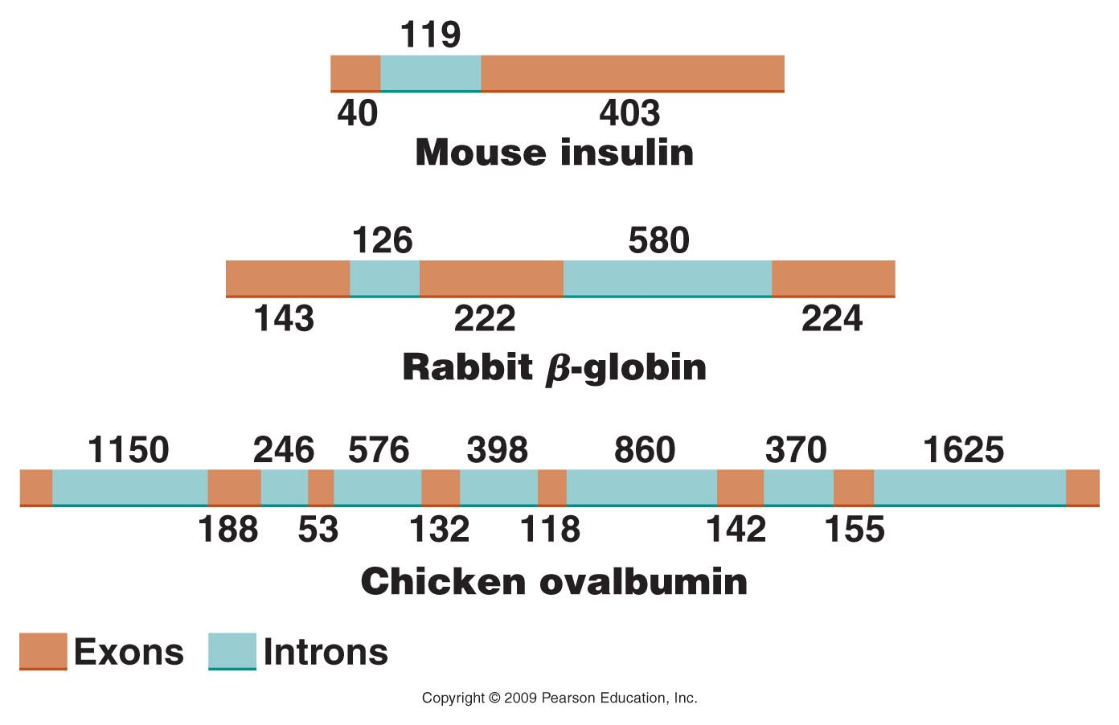
Figure 14.12
Notes:
Figure 14-12 Intervening sequences in various eukaryotic genes. The numbers indicate the number of nucleotides present in various intron and exon regions.

Slide 20
Pre-mRNA =1295 nucleotides
Before translation can begin, introns are removed and exons are spliced together
Mature mRNA =589 nucleotides

Slide 21
Recall the mRNA is modified at both ends
5’----
----3’
5’ Methyl-Guanosine “cap”
3’ polyAdenosine “tail”

Slide 22
Recall the mRNA is modified at both ends
5MeG’----
AAAAAAAAAAAAAAAA₍₁₀₀₋₂₀₀₎---3’
Assumed that the modifications of the mRNA aid its export from the nucleus and mark the RNA as ready for translation.

Slide 23
Gene expression regulation
How do different cell types come to express unique subsets of proteins?

Slide 24
Recall the structure of genes
General structure of a gene.
Regulatory sequences—eg. the PROMOTER
Protein-coding sequences
Transcription actually starts here
Usually “upstream” from the start site for transcription

Slide 25
Each cell type has a unique set of regulatory factors/proteins that bind to only a subset of genes and induce their transcription.
These transcription regulation proteins are called:
  Transcription Factors

Slide 26
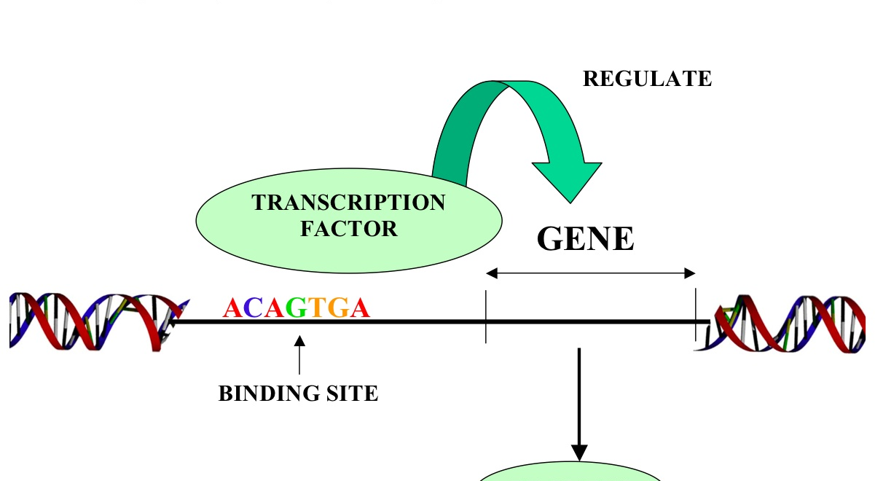
For example, this gene might be expressed only in muscle cells. In that case, we would assume the transcription factor protein would be made only in muscle cells.

Slide 27
Animations
http://highered.mheducation.com/sites/0072943696/student_view0/chapter3/animation__mrna_synthesis__transcription___quiz_2_.html
http://www.dnalc.org/view/15510-Transcription-DNA-codes-for-messenger-RNA-mRNA-3D-animation-with-basic-narration-.html

Slide 28
How is mRNA translated into protein
Code= nucleotide sequence of mRNA
Product= amino acid sequence
Work during the 1950s and 1960s by Sydney Brenner and Francis Crick cracked the code.

Slide 29
The code—Translation
Be familiar with the list of 9 items to describe the code. Text p. 316
  Brenner agued theoretically that the code must be at least 3 nucleotides to cover all 20 amino acids.
  On white board…

Slide 30
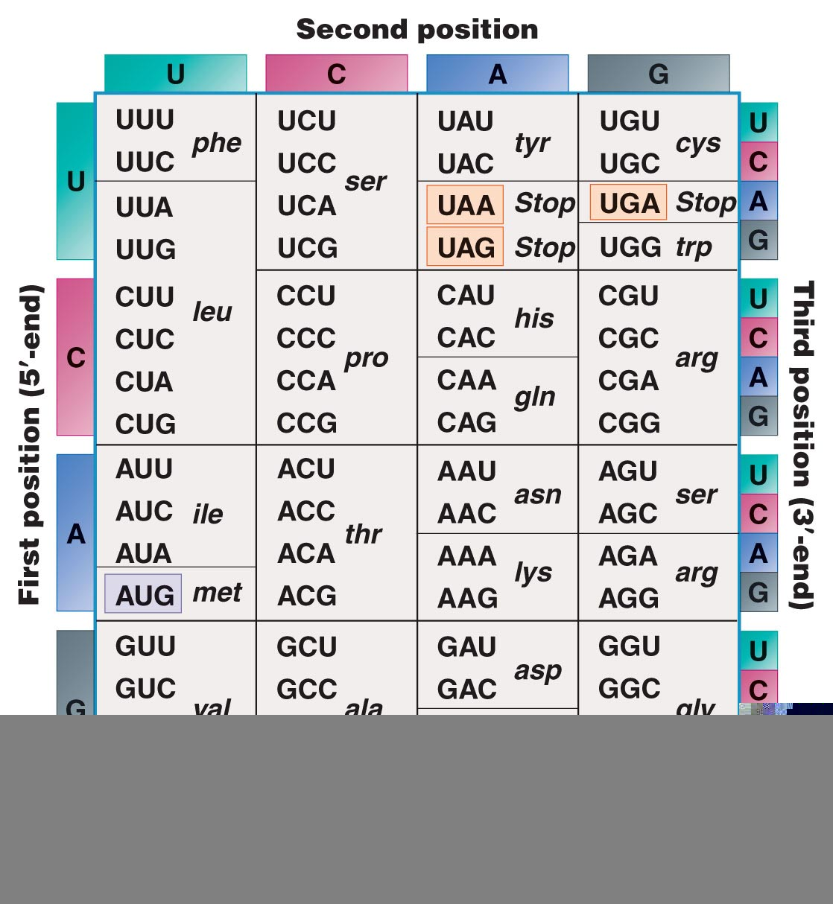
Figure 14.7
Figure 14-7 Copyright © 2006 Pearson Prentice Hall, Inc.
Notes:
Figure 14-7 The coding dictionary. AUG encodes methionine, which initiates most polypeptide chains. All other amino acids except tryptophan, which is encoded only by UGG, are represented by two to six codons. The codons UAA, UAG, and UGA are termination signals and do not encode any amino acids.

Slide 31
The code…
Code in the mRNA nucleotide sequence is called the codon
Code is read 5’---3’ in the mRNA
The code is unambiguous! Each codon specifies one and only one amino acid. (e.g. UUU in mRNA specifies Phenylalanine only. UUU never specifies leucine…)

Slide 32
Continued…
With 64 combinations of nucleotides in codons, and only 20 amino acids, most amino acids have more than one codon ( e.g. phenlalanine is encoded by UUU AND UUC)
Thus the code is thus said to be degenerate or redundant.

Slide 33
Some codons serve as special signals in translation
  Start codon =AUG (proteins are always started by Methionein. )
  UAA UAG UGA = Stop codons. They do not specify any of the 20 AA so translations halts when ribosomes encounter one of the stop codons.

Slide 34
Continued…
The mRNA code (in mature—intron-less mRNA) is “commaless”. Translation proceeds from the start codon through the stop codon.
  This region of the mRNA is called an Open Reading Frame (ORF)

Slide 35
Continued…
The code is (nearly)universal!!
  Have you observed this personally?

Slide 36
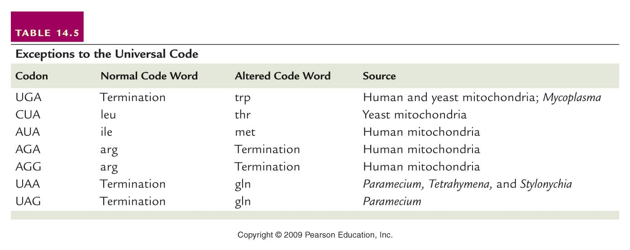
Only a few exceptions to the universality of the code.
Table 14.5
Notes:
36
Table 14-5 Exceptions to the Universal Code

Slide 37
Let’s practice using the code:
  Recall the central dogma…
  On board.
  https://dnalc.cshl.edu/resources/3d/15-translation-basic.html

